Slide 1
MESC
Update on SDAC & SIDC
08 October 2026

Slide 2
PCG Update on SDAC & SIDC
Summary
  Main Takeaways – MCSC is delivering
  The deployment of XBID R5.0 has increased XBID performance significantly and thereby offer to MPs improvements in system latency. While trades continue to increase, performance has been stable.
  After a thorough testing campaign, Core Advanced Hybrid Coupling went live successfully on 10/06. This is an improvement in the calculation of cross-border capacities for Core external borders.
  The next slate of major projects have started implementation: for FB in IDAs and CE CCR, implementation has started. R&D for co-optimisation and FB in Continuous trading is ongoing.

Slide 3
Market coupling IT architecture
This is the way it works – is it not?
Market data
(collected in bidding zones)
Cross-zonal capacities
(computed in capacity calculation regions)
Consumption bids
Market Operators
Power system
Generation and load forecast
Nemos
Pan-European
Trading systems
Cross-zonal capacities
Price Coupling/ Matching Algorithms
Transmission System Operators +
Regional Coordination Centres
Generation bids

Slide 4
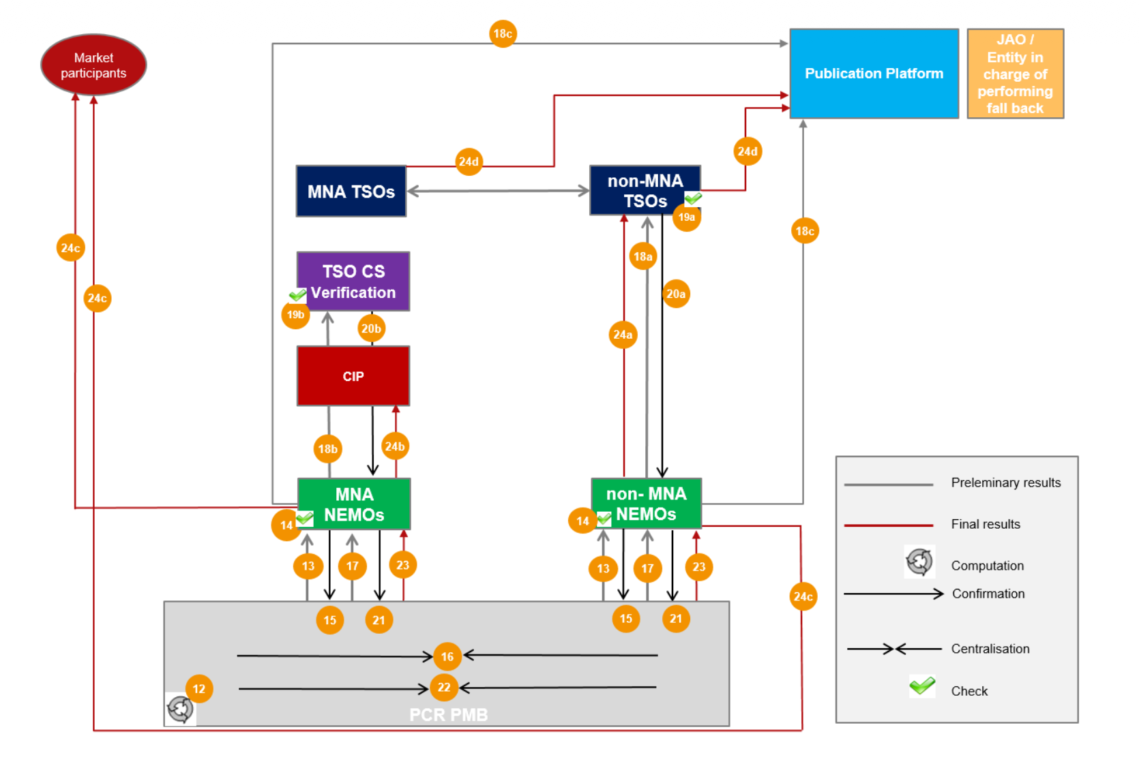
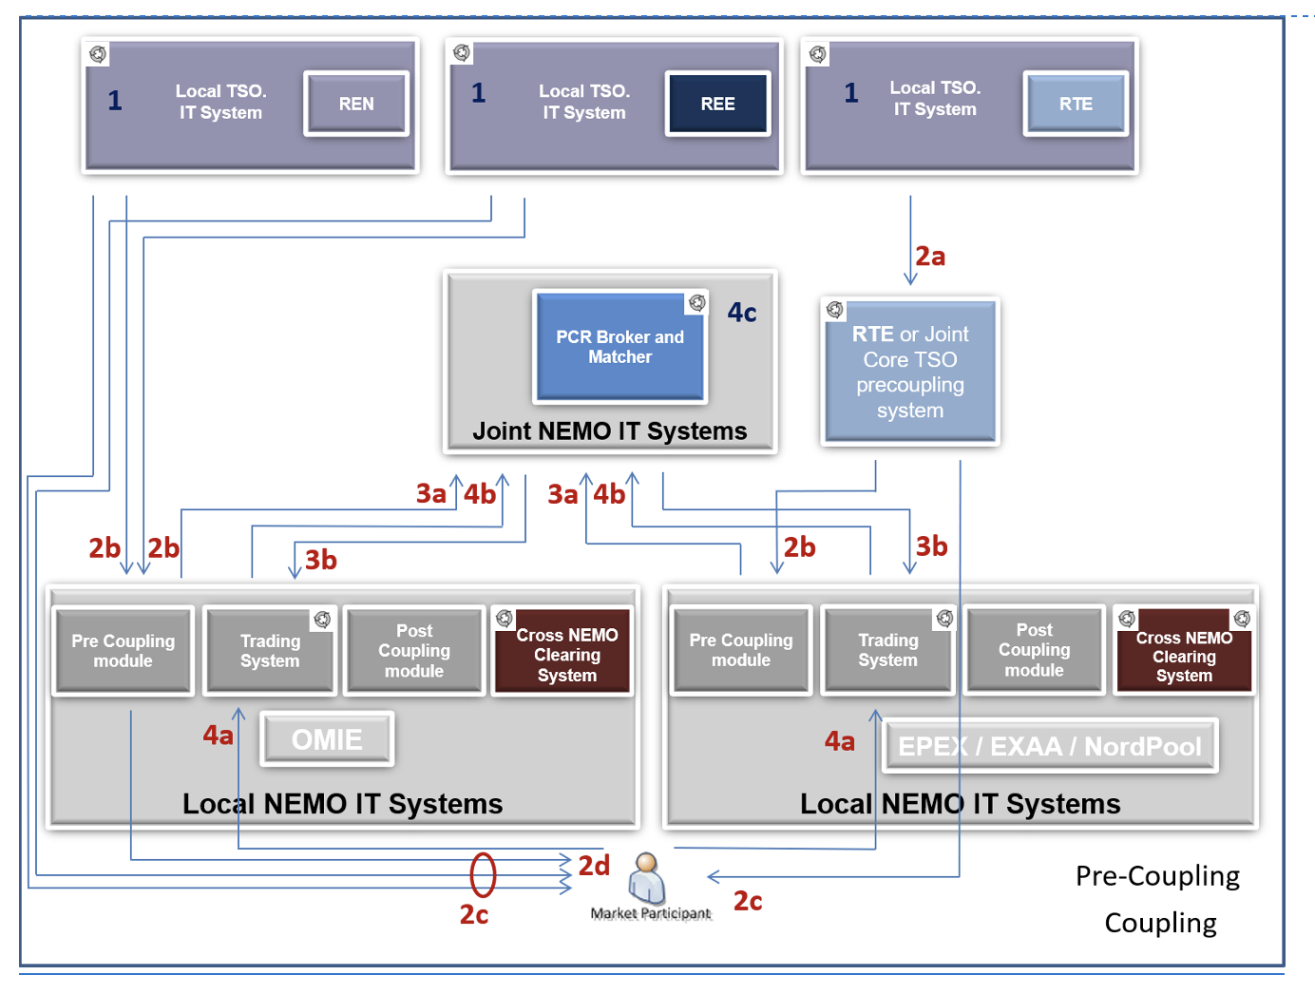
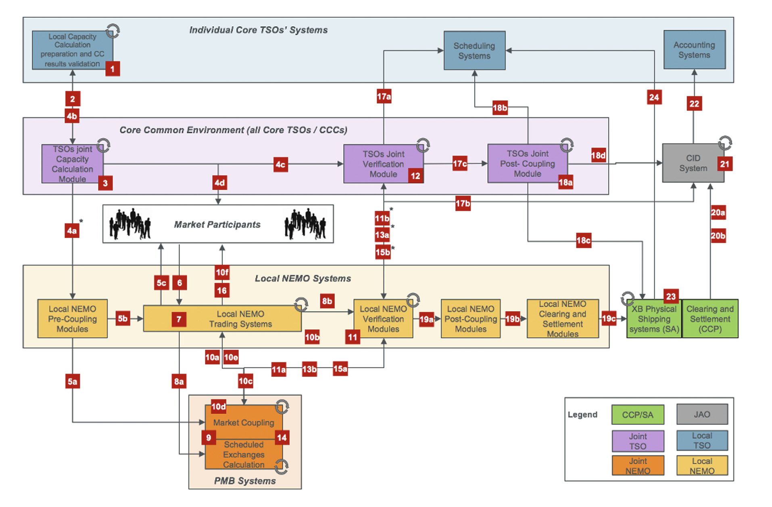
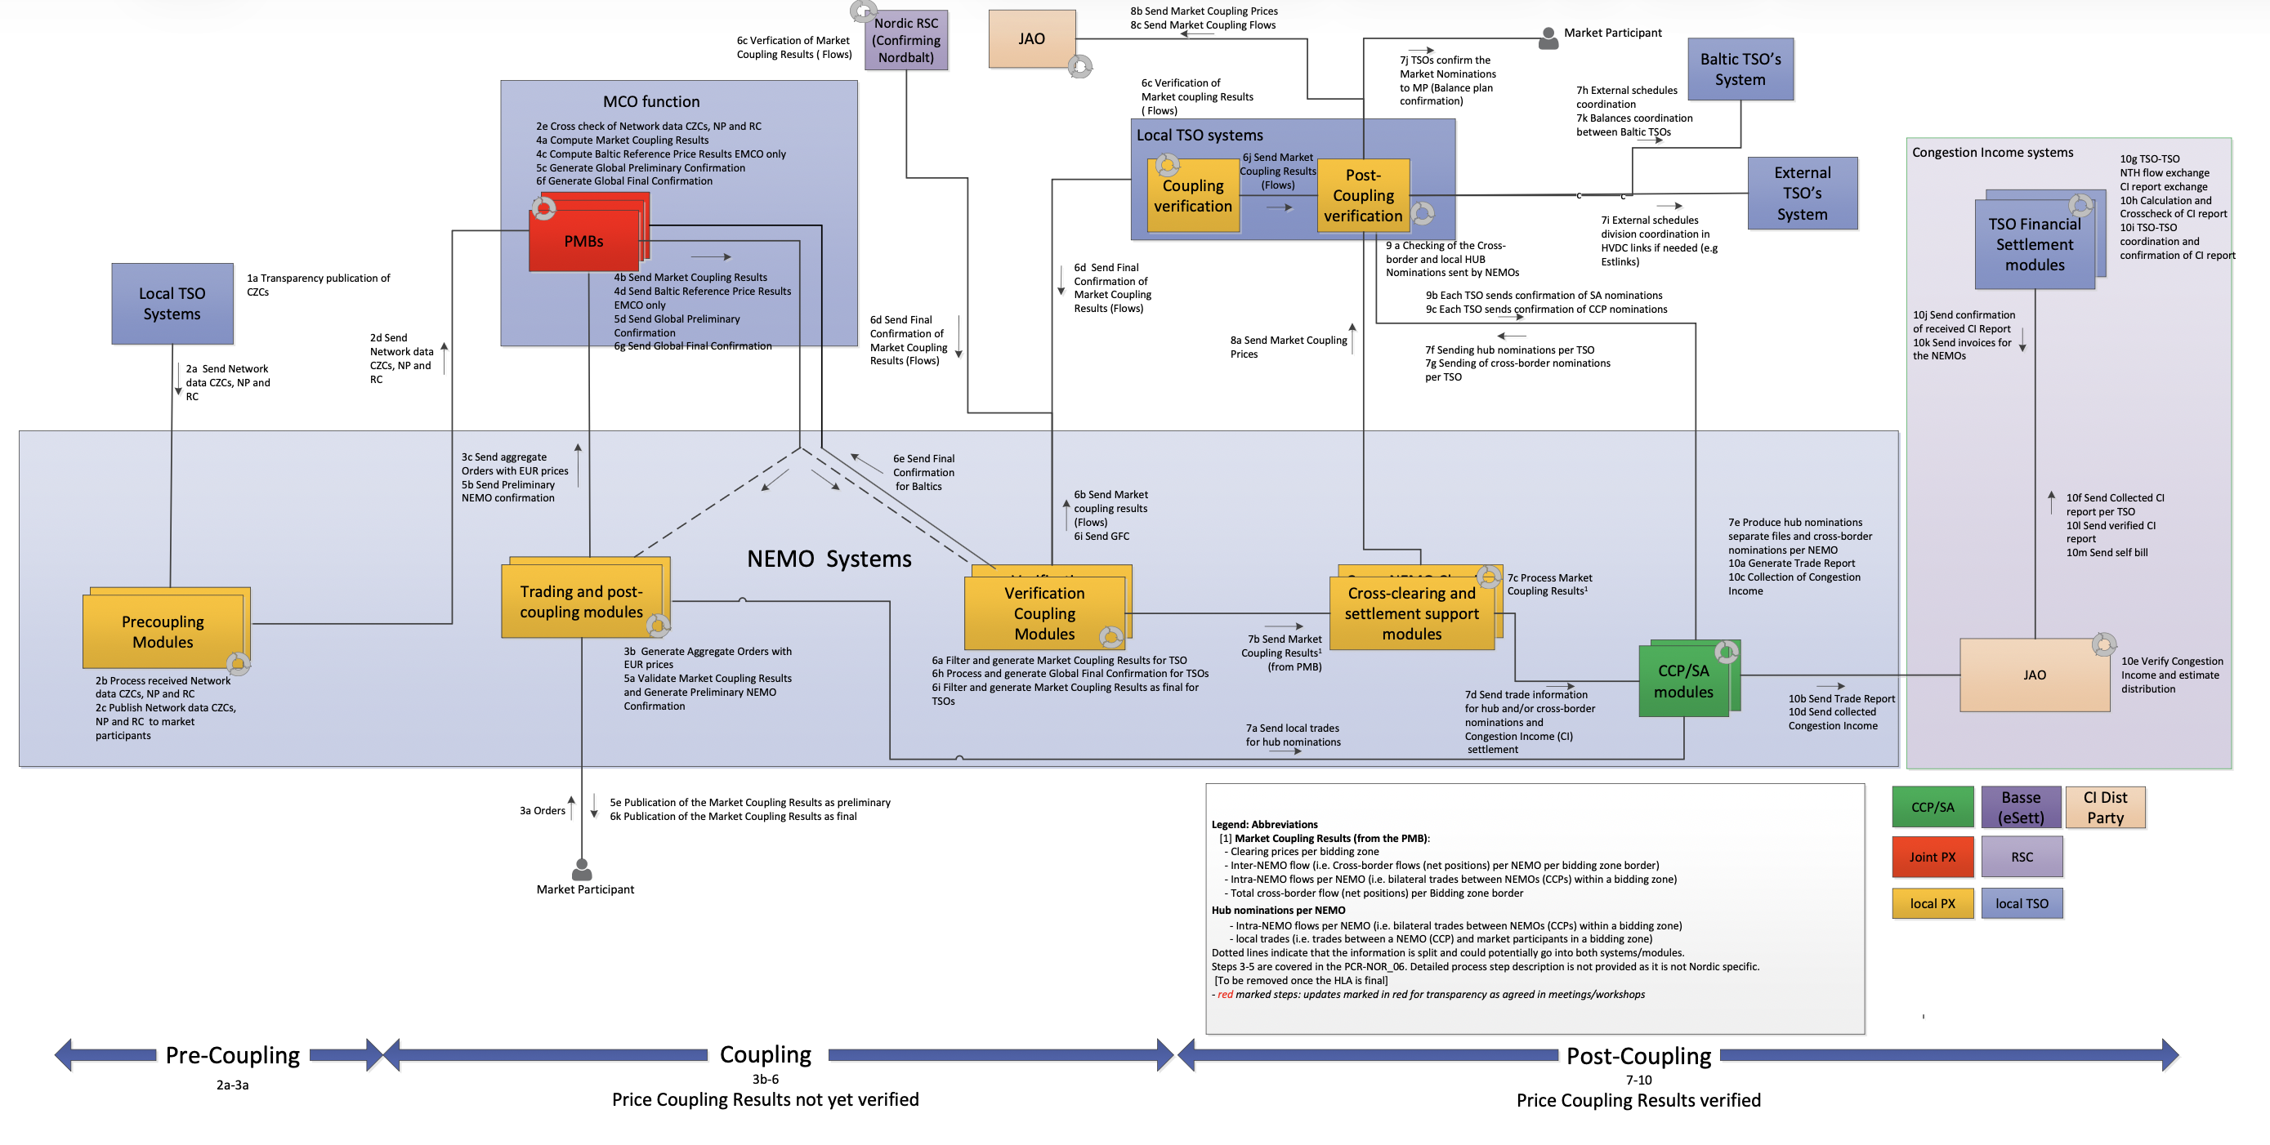
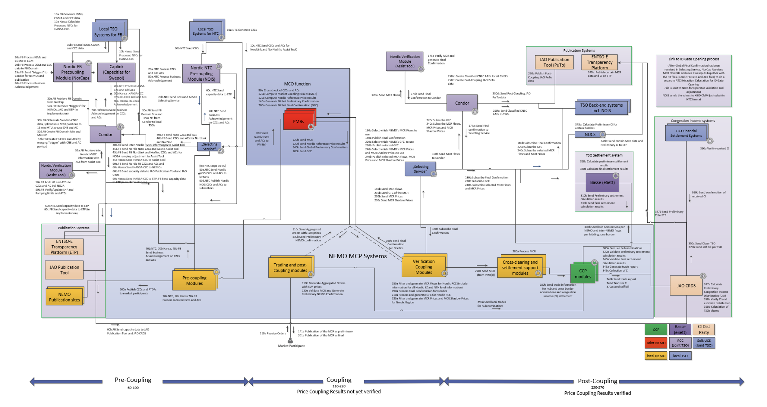
Market coupling IT architecture
Market Coupling architecture has evolved with the implementation projects over the past 12 years(illustrative)
+
+
+
= ?

Slide 5
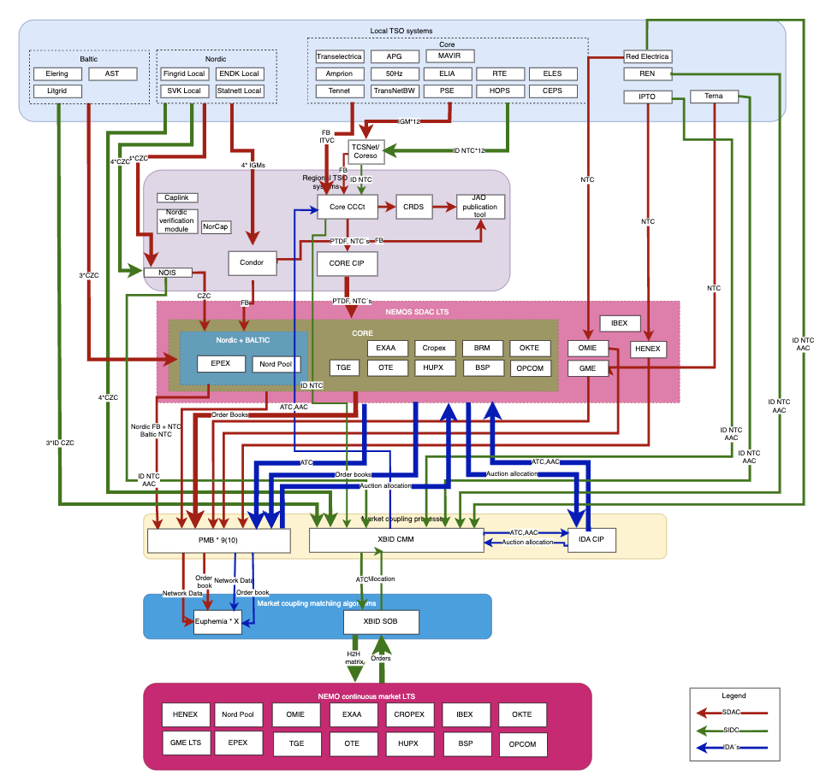
Market coupling IT architecture
Market (Pre-)Coupling logical architecture shows the implications of incremental development
Information flows and accountability
Architecture and dependencies
+
Initial
pain points
Changeability and lifecycle
Performance, resilience and operations

Slide 6
Market coupling IT architecture
Incremental development has created multiple, interconnected architectural patterns
Architecture and dependencies
The IT landscape has grown over multiple implementation projects and expanded with new requirements and geographical extensions.
SDAC distributes execution and dependency across organizations. This partially, logically separates the algorithm from Market Coupling process through a separate layer.
SIDC (CT) concentrates transactional processing and authoritative state in a central platform while deploying separate modules for interfacing TSOs and NEMOs.
IDA´s utilize both SDAC and SIDC infrastructure
IDA Complexity
Decouples
Central platform

Slide 7
Market coupling IT architecture
Similar information follows different paths and accountability models
Information flows and accountability
Regional differences
Similar TSO information follows different paths across market timeframes and regions. In SDAC network and results data is passed through NEMO´s(to PMB and Euphemia) while in SIDC this is directly sourced with XBID.
Regional implementation diversity creates integration, testing and operational complexity independently of the matching systems.
Data ownership, transport, transformation, orchestration and processing may sit with different parties for similar functionalities depending on region and market timeframe.
Root cause identification in the case of incidents can be challenging
NEMO intermediaries
Direct interface

Slide 8
Market coupling IT architecture
Performance and resilience depend on the end-to-end architecture, not one component
Performance, resilience and operations
Reported performance issues occur at different points: algorithms, ordered processing, message transport, file exchange, shipping and decoupling scenarios.
Root cause understanding of performance issues will require timestamps, volumes, queue profiles, algorithm distributions and recovery evidence.
The largely separate SDAC and SIDC architectures in the coupling layer offer redundancy in the case of incidents
SDAC
SIDC

Slide 9
Market coupling IT architecture
Operational stability does not by itself demonstrate long-term future fitness
Changeability and lifecycle
Change and testing scope follows technical and organisational dependencies, not only the function being changed.
Similar changes may require parallel implementation and regression testing across different processes.
Long-term lifecycle, knowledge ownership and platform dependencies across central systems need explicit assessment to reveal architectural constraints, dependency concentration and future optionality before major investment decisions
Operationally stable does not automatically mean fit for the next decade.
Explicit assessment
needed

Slide 10
In the next period we will utilize the common information base we have created to develop scenarios for the future Market Coupling IT architecture vision
Activities in next period
Finalise post-coupling HLA
Finalise review of pain points
Gather and review current performance data
Assess costs for developing and operating MC IT architecture
Gather future requirements
Develop future scenarios for the IT architecture vision
Plan for RFI phase to make evidence-based decision-making related to central systems
Key milestones:
Future requirements and scenarios deliveries for MCSC in November and Q1

Slide 11
SDAC-SIDC Roadmap and Key Projects
2026
2027
2028
Activity
Q3
Q4
Q1
Q2
Q3
Q4
Q1
Q2
Euphemia/PMB
Euphemia & PMB releases
PMB15.0/E12.2
Improvements & optimisation
Algorithm performance improvement
SIDC
Q3 2028
Performance and minor functionalities
Performance roadmap
XBID R5.1 /LTS
FB in IDAs
X-R6.0 / CIP 3.0 / PMB 15.0 / E13.0 / LTS / Regional systems
FB in CT
Approach A – Solver-based — R&D
R&D
Approach E – Dynamic recalculation - R&D
Approach E – Dynamic recalculation – Testing (12 month)
SDAC R&D
  Co-optimisation R&D
Report R2
R&D Phase III
  Continuous improvements/ Euphemia Lab
Continuous performance improvements
SIDC Go-live windows
  Go-live window 2-2026
Testing and GL
Go-live window 1-2027
W2 – 2026
Slovenian MNA (IDA/CT)
Testing and GL
Go-live window 2-2027
Q4 – 2026
Slovenian MNA (DA)
CCCt v4.3/RLI
ETPA DA NL
Croatian MNA (DA)
W1 – 2027 – Proposed
SEM MNA
Baltic Cable
Croatian MNA IDAs/CT
ETPA CT in AT, FR, BE
Testing and GL
Go-live window 1-2028
Q3 – 2026
EPEX Baltic
W2 – 2027 – Proposed
ETPA IDAs
Testing and GL
SDAC go-live windows
W1 – 2028 – Proposed
Celtic IC
Go-live window Q3 – 2026
Imp./test period
Q1 – 2027 – Proposed
SEM MNA
EnC GLW
Go-live window Q4 – 2026
Implementation/test period
Q2 – 2027 – Proposed
Hansa Phase 2b
Go-live window organisation
Go-live window Q1 – 2027
Implementation/test period
Q3 – 2027 – Proposed
Go-live window Q2 – 2027
Implementation/test period
Go-live window Q3 – 2027
Implementation/test period
Q4 – 2027 – Proposed
Q1 – 2028 – Proposed
CE CCR
EnC GLW
Go-live window Q4 – 2027
Implementation/test period
Go-live window Q1 – 2028
Implementation/test period
Go-live window Q2 – 2028
LTFBA controlled deployment period
Controlled deployment period
CE CCR in DA
Implementation and testing (indicative)
CE DA Int // run
CE DA Ext // run
Regional requirements
SIDC Related
30 IDCZGCT - Local implementation
NL, HU
BE, BG, SE
DK
Confirmed planning
Indicative planning

Slide 12
SDAC

Slide 13
Main Bulletins – SDAC Status Updates
SDAC Co-optimisation
Co-optimization R&D R2 Phase 1 results summary based on the intermediate report
  The Phase 1 simulations featured the co-optimisation of 5 markets (energy, aFRR-up, aFRR-down, mFRR-up, mFRR-down) in the Baltic region. N-SIDE has delivered an intermediate report highlighting key findings of this simulation phase.
  At market-participant level, the intermediate results show that plant characteristics matter for bid volumes and prices generated—directly affecting an asset’s competitiveness.
  On an aggregate market level, the results confirm that prices across borders may converge, the upward BC price is closely linked to the energy price, and cross-product substitution can align aFRR and mFRR prices.
  Results also showed interactions between energy demand and the down BC price, the latter potentially increasing towards the price cap under certain conditions.
  However, it is to be noted that the prototype for Phase 1 does not include decreasing marginal costs and that the current mechanisms to find solutions and prices in Euphemia may be ill-suited for co-optimization.

Slide 14
Main Bulletins – SDAC Status Updates
SDAC Co-optimisation
Co-optimization R&D R2 report planning
  After the finalization of Phase 1, Phase 2 simulations for the whole SDAC region with an updated prototype including new features (e.g. FB requirements, combined thermal bids and storage orders) will follow. Preparation of Phase 2 simulations is currently ongoing.
  Given the prolonged Phase 1 efforts, including additional assessments of the results and prototype behavior by N-SIDE as well as establishing the necessary contractual obligations with a service provider, the Co-opt R2 planning was further updated.
  The assumption is that the Phase 2 simulations will commence in mid-October and run until the end of 2026. Under the revised schedule, Co-opt SG will prepare the R2 report in Q1 2027 and finalise it in April 2027, after which the report will be submitted to MCSC for approval and then to ACER.

Slide 15
Main Bulletins – SDAC Status Updates
Storage orders
NEMOs and TSOs have received positive feedback from market parties on storage orders, but also requests for additional requirements
  The public consultation on storage orders closed on 14 July. In total, 39 responses were received, covering all SDAC Member States. Responses were received from individual traders, storage owners, aggregators, as well as associations such as Eurelectric and few additional member-state level associations (e.g. UFE, Armie, AIGET). Responses are being analysed and feedback to market parties will be provided in the MCCG on 22/10.
  General points raised in the submitted responses:
    Introduction of the storage order type was welcomed by the respondents.
    The respondents highlighted that the introduction of storage orders should not have an impact on calculation time extension nor on the product offering of individual NEMOs (i.e. support and development of existing products should be maintained).
    Respondents provided many suggestions on potential additional parameters to better reflect their needs especially regarding the pumped hydro storage systems, though they highlighted that additional parameters should not be introduced if they have large negative algorithm performance impact.
  MSD is working now on new data for simulations. The new data will better reflect the expected future market as well as the input from the public consultation.
  Additional parameters suggested in the public consultation are being assessed together with N-SIDE so that the storage order design is improved fitting the market needs without substantially increasing the complexity of the algorithm.
  Based on the simulation outcomes, the final design will be confirmed to be part of E12.3 (expected GL end/2027).

Slide 16
Main Bulletins – SDAC Status Updates
Core AHC
NEMOs and TSOs are happy to report the Core AHC go-live was fully successful
  The go-live of Core AHC was well-executed: no operational incidents in market coupling.
  The impact on TTFS (see below) is in range with expectations.
Core AHC (10/06)
Jan | Feb | Mar | Apr | May | Jun | Jul | Aug | Sep

Slide 17
Main Bulletins – SDAC Status Updates
SDAC Fallback Improvement Measures
Main Outcomes
  NEMOs and TSOs have drafted a comprehensive overview on the available options to mitigate decoupling risks, following the initiative from ACER.
  This document will be discussed in the next PCG fallback WS.
  In parallel, implementation of volume allocation at NEMOs in Core MNA areas has progressed further. The only NEMOs still pending full implementation are OPCOM and TGE.
  The first biannual operational timings and improvement report has been provided to ACER.
Number | Description
WS4.1 | NEMOs and TSOs to review ACER’s single consolidated document, add the relevant information and descriptions of the procedures for replacing shadow auctions with the continuous trading mechanism, and provide preliminary comments – deadline: 15 July per the action table, end of July per the text of the summary.
Action WS2.1 | NEMOs and TSOs to confirm the allocation of additional 30 minutes available after moving the deadline from 15:30 to 16:00 (under the assumption of full removal of shadow auctions and implementation of CT ID as fallback – see WS 4) – deadline: next workshop.
Continuous action | TSOs and NEMOs to report on the optimisation of procedures and propose further improvements of the SDAC, SIDC, ANDOA and ANIDOA procedures on a bi-annual basis, together with the updated, unredacted set of all procedures.

Slide 18
Main Bulletins – SDAC Status Updates
SDAC Incidents
SDAC Major¹ incident 17/05 — Report from NEMO Committee
  The initial calculation was completed successfully at 12:41. However, the affected party’s preliminary confirmation was missing in PMB. The affected party confirmed an issue with portfolio allocation. The coordinator triggered the Market Coupling Incident Committee at 12:50.
  NEMOs sent out the SDAC_EXC_02 Delay in Market Coupling Results publication, notifying stakeholders of a delay in Market Coupling Results publication.
  At 13:10, UMM_01a Delay in final Market Coupling Results publication was sent by CORE parties to notify about further delay (UMM_01a shall become a central SDAC message from May 20 onwards). The affected party rejected the results in PMB at 13:33 and per procedure requested a new calculation, claiming Portfolio allocation issues. An erroneous preliminary confirmation at 13:35 led to unintended validation and partial publication of the preliminary results.
  The Market Coupling Session was restarted at 13:37, with a new calculation window set to 20 minutes. The coordinator instructed TSOs not to validate the initial results and confirmed that new results would follow the second calculation.
  At 13:50 NEMOs forwarded SDAC_EXC_03 Further delay of the Market Coupling Session – Risk of Full Decoupling message to the market and TSOs to initiate fallback allocation processes.
  The second calculation was completed at 14:05, and updated results were shared. Preliminary results were published to market at 14:19. At 14:30, the final results were published, concluding the incident management process.
  Following the incident caused by validation failures, additional test cases shall be defined to cover missing scenarios, including edge cases and invalid inputs. Testing activities shall be performed with higher frequency to ensure earlier detection of similar issues. The portfolio allocation process shall be enhanced to provide more detailed and structured logging. This improved logging will facilitate faster diagnosis and resolution of incidents by providing clearer traceability.
  With respect to the wrongfully published preliminary results, implementation of additional checks of preliminary confirmations directly in PMB shall be investigated together with the service provider.
  From procedural point of view, the discussion has been initiated on introducing additional operational messages, to provide more clarity and comfort to the market, especially around the critical timings, such as 14:20 (FD deadline).
1. By “Major Incident” we understand an incident which either led to a SDAC Partial or Full Decoupling or which at least created a risk of Partial or Full Decoupling.

Slide 19
SIDC

Slide 20
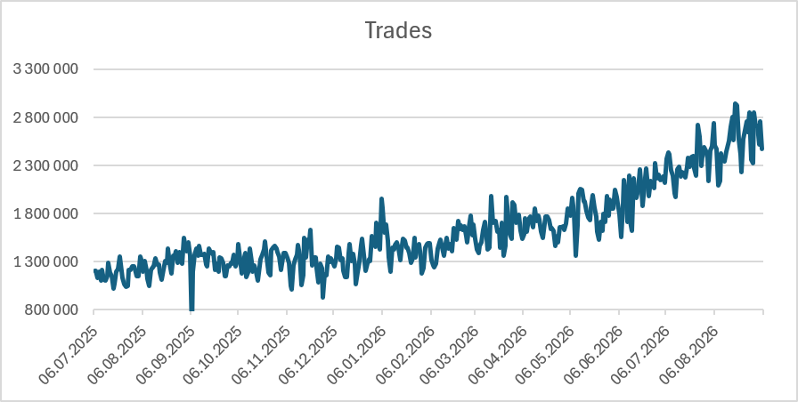
Main Bulletins – SIDC Status Updates
XBID upgrade
  XBID R5.0 went live successfully
  The go-live of the first large system release after IDAs focussed on performance, given the large increase in system usage and trades in SIDC.
  The go-live was successful from an operational point of view, occurring without any incident.
  After the go-live, a reduction in latencies was observed by market parties.
  In the months following, the usage of XBID (in both orders and trades) continued to increase.
  Even with this increased in usage, performance of the platform has been stable.
XBID 5.0

Slide 21

Main Bulletins – SIDC Status Updates
Corrective Measures in XBID
  NEMOs and TSOs have agreed on several corrective measures, with 2 more under investigation
  All stakeholders have been informed of the status of corrective measures in a paper published on 12/05.
  Corrective measures — agreed:
  Adjustment of Price Tick Size
    The testing with market parties has, on request of members, been extended to 11/09.
  Decrease in Order Book Depth
    Testing is ongoing at the time of writing (planned until 18/09)
  Corrective measures — under investigation:
  Order management measures
    NEMOs want to ensure that no anticompetitive effects are enacted by order management measures. Therefore, a comprehensive legal review is conducted by an independent firm. This is ongoing.
Available on ENTSO-E and NEMO Committee websites

Slide 22
Main Bulletins – SIDC Status Updates
Flow-Based in SIDC
  Reminder of status flow-based in IDAs
  Design phase - completed
  Implementation phase - planned and started
    XBID R6.0 (FB in IDA) was extended with CMM module infrastructure changes addressing performance impact of FB in IDA foreseen by the XBID provider.
  Testing phase
    Detailed planning is prepared considering XBID R5.1 (performance and other improvements) and R6.0 (FB in IDA) simultaneous testing.
    Member testing is expected to take place in period October 2027 and go-live in the month after.
  As implementation is ongoing, there are no major updates to be provided

Slide 23
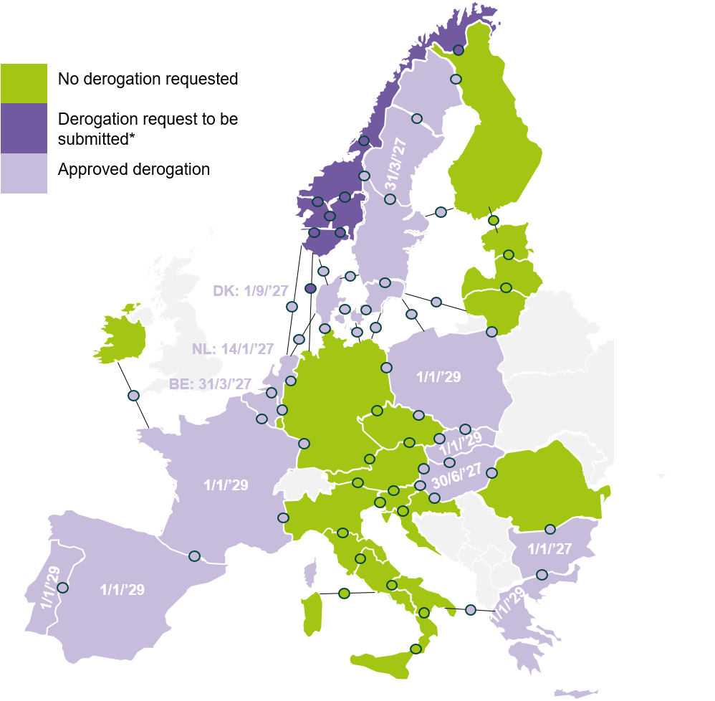
Main Bulletins – SIDC Status Updates
30-Minute IDCZGCT
The 30-minute IDCZGCT is efficiently in operation in all countries marked with green.
Most derogation requests were approved by NRAs*.
A high-level go-live plan was presented in March, details of the upcoming go-lives in 2026 Q4 and 2027 Q1 are currently under discussion.
Update on the planned go-live dates will be provided during the next MCCG in October.
Details on the go-live may be found on the [ENTSO-E] website
* Derogation request will only be officially submitted by Statnett after transposition of relevant regulation in Norway.

